Slide 1
Chapter 2 – Design and Implementation
Software Architecture and Design
Mutah University
Faculty of IT
Department of Software Engineering
Dr. Ra’Fat A. AL-Msie’Deen
rafatalmsiedeen@mutah.edu.jo
https://rafat66.github.io/Al-Msie-Deen/

Slide 2
References
Textbook
Title | Documenting Software Architectures: Views and Beyond
Author(s) | Paul Clements et al.
Publisher | Addison- Wesley
Year | 2010
Edition | 2nd Edition
Book Website
References | TBA in the class – refer to the website Ian Sommerville. Software Engineering (l0th Edition). Addison Wesley, 2015, ISBN-10: 0137035152.

Slide 3
Object-oriented design using the UML

Slide 4
An object-oriented design process
An object-oriented system is made up of interacting objects that maintain their own local state and provide operations on that state.
The representation of the state is private and cannot be accessed directly from outside the object.
Object-oriented design processes involve designing object classes and the relationships between these classes.
These classes define the objects in the system and their interactions.
When the design is realized as an executing program, the objects are created dynamically from these class definitions.

Slide 5
An object-oriented design process
Objects include both data and operations to manipulate that data.
They may therefore be understood and modified as standalone entities.
Changing the implementation of an object or adding services should not affect other system objects.
Because objects are associated with things, there is often a clear mapping between real-world entities (such as hardware components) and their controlling objects in the system.
This improves the understandability, and hence the maintainability, of the design.

Slide 6
An object-oriented design process
To develop a system design from concept to detailed, object-oriented design, you need to:
Understand and define the context and the external interactions with the system.
Design the system architecture.
Identify the principal objects in the system.
Develop design models.
Specify interfaces.

Slide 7
An object-oriented design process
Like all creative activities, design is not a clear-cut, sequential process.
You develop a design by getting ideas, proposing solutions, and refining these solutions as information becomes available.
You inevitably have to backtrack and retry when problems arise.
Sometimes you explore options in detail to see if they work; at other times you ignore details until late in the process.
Sometimes you use notations, such as the UML, precisely to clarify aspects of the design; at other times, notations are used informally to stimulate discussions.

Slide 8
An object-oriented design process
I explain object-oriented software design by developing a design for part of the embedded software for the wilderness weather station that I introduced in SE course.
Wilderness weather stations are deployed in remote areas.
Each weather station records local weather information and periodically transfers this to a weather information system, using a satellite link.

Slide 9
An object-oriented design process
Structured object-oriented design processes involve developing a number of different system models.
They require a lot of effort for development and maintenance of these models and, for small systems, this may not be cost-effective.
However, for large systems developed by different groups design models are an important communication mechanism.

Slide 10
Process stages
There are a variety of different object-oriented design processes that depend on the organization using the process.
Common activities in these processes include:
Define the context and modes of use of the system;
Design the system architecture;
Identify the principal system objects;
Develop design models;
Specify object interfaces.
Process illustrated here using a design for a wilderness weather station.

Slide 11
Object-oriented design using the UML
System context and interactions

Slide 12
System context and interactions
Understanding the relationships between the software that is being designed and its external environment is essential for deciding how to provide the required system functionality and how to structure the system to communicate with its environment.
Understanding of the context also lets you establish the boundaries of the system.
Setting the system boundaries helps you decide what features are implemented in the system being designed and what features are in other associated systems.

Slide 13
System context and interactions
The first stage in any software design process is to develop an understanding of the relationships between the software that is being designed and its external environment.
This is essential for deciding how to provide the required system functionality and how to structure the system to communicate with its environment.
As I discussed in SE course, understanding the context also lets you establish the boundaries of the system.

Slide 14
System context and interactions
Setting the system boundaries helps you decide what features are implemented in the system being designed and what features are in other associated systems.
In this case, you need to decide how functionality is distributed between the control system for all of the weather stations and the embedded software in the weather station itself.

Slide 15
System context and interactions
System context models and interaction models present complementary views of the relationships between a system and its environment:
A system context model is a structural model that demonstrates the other systems in the environment of the system being developed.
An interaction model is a dynamic model that shows how the system interacts with its environment as it is used.

Slide 16
System context and interactions
The context model of a system may be represented using associations.
Associations simply show that there are some relationships between the entities involved in the association.
You can document the environment of the system using a simple block diagram, showing the entities in the system and their associations.

Slide 17
System context and interactions
Figure 1 shows that the systems in the environment of each weather station are a weather information system, an onboard satellite system, and a control system.
The cardinality information on the link shows that there is a single control system but several weather stations, one satellite, and one general weather information system.

Slide 18
Context and interaction models
A system context model is a structural model that demonstrates the other systems in the environment of the system being developed.
An interaction model is a dynamic model that shows how the system interacts with its environment as it is used.

Slide 19
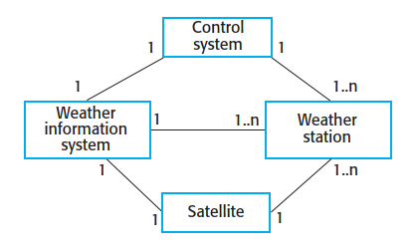
System context for the weather station
Figure 1. System context for the weather station

Slide 20
The use case model
When you model the interactions of a system with its environment, you should use an abstract approach that does not include too much detail.
One way to do this is to use a use case model.
As I discussed in SE course, each use case represents an interaction with the system.
Each possible interaction is named in an ellipse, and the external entity involved in the interaction is represented by a stick figure.

Slide 21
The use case model
The use case model for the weather station is shown in Figure 2.
This shows that the weather station interacts with the weather information system to report weather data and the status of the weather station hardware.
Other interactions are with a control system that can issue specific weather station control commands.
The stick figure is used in the UML to represent other systems as well as human users.

Slide 22
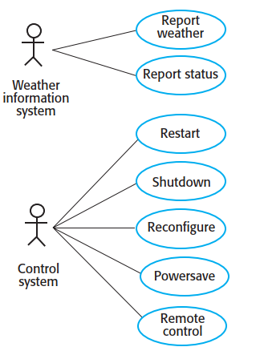
Weather station use cases
Figure 2. Weather control station use cases.

Slide 23
Use case description
Each of these use cases should be described in structured natural language.
This helps designers identify objects in the system and gives them an understanding of what the system is intended to do.
I use a standard format for this description that clearly identifies what information is exchanged, how the interaction is initiated, and so on.

Slide 24
Use case description
As I explain in SE, embedded systems are often modeled by describing how they respond to internal or external stimuli.
Therefore, the stimuli and associated responses should be listed in the description.
Figure 3 shows the description of the Report weather use case from Figure 2 that is based on this approach.

Slide 25
Use case description—Report weather
Figure 3. Use case description—Report weather.
System | Weather station
Use case | Report weather
Actors | Weather information system, Weather station
Description | The weather station sends a summary of the weather data that has been collected from the instruments in the collection period to the weather information system. The data sent are the maximum, minimum, and average ground and air temperatures; the maximum, minimum, and average air pressures; the maximum, minimum, and average wind speeds; the total rainfall; and the wind direction as sampled at five-minute intervals.
Stimulus | The weather information system establishes a satellite communication link with the weather station and requests transmission of the data.
Response | The summarized data is sent to the weather information system.
Comments | Weather stations are usually asked to report once per hour but this frequency may differ from one station to another and may be modified in the future.

Slide 26
Object-oriented design using the UML
System context and interactions
Architectural design

Slide 27
Chapter 2 – Design and Implementation
Software Architecture and Design
Mutah University
Faculty of IT
Department of Software Engineering
Dr. Ra’Fat A. AL-Msie’Deen
rafatalmsiedeen@mutah.edu.jo
https://rafat66.github.io/Al-Msie-Deen/

